Slide 1

Route Optimization Software for Inventory Management in Warehouses
by
SAGAR BHAURAO CHANDEWAR
in
METALLURGiCAL AND MATERIALS ENGINEERING,
IIT Kharagpur
Indian Institute of Technology Kharagpur
November, 2021

Slide 2
Contents
Introduction 1.1) Amazon’s warehouse model
2. Problem Definition 2.1) Why randomness works? 2.2) Defined warehouse unit 2.3) Problem
3. Related Work 3.1) Operations and Operating Expenses in Warehouse 3.2) Warehouse Layouts, Storage strategies and Picking approaches 3.3) Genetic Algorithm for Route Optimization
4. Methodology 4.1) 2-opt Algorithm 4.2) Software Flow

Slide 3
5. Results and Discussion 5.1) Sample input and Output
6. Futurework
7. References and Project link

Slide 4
Introduction
Evolution of customer behavior due to E-commerce is the reason for many changes in the industry's supply chain
These changes are affecting workplaces around the world and Distribution Centers or Warehouses are one of them.
Enterprise resource planning (ERP) solutions are now added to fundamentals of how large enterprises run, but these solutions haven't been robust on executions which involve warehouse management tasks and demand planning.
Having warehouses which are Agile and Adaptable to change in market conditions is now becoming a critical condition.
Advantages of e-commerce are experiencing the challenge of fulfilling expectations of customers to get cheaper rates, faster shipping and delivery.

Slide 5
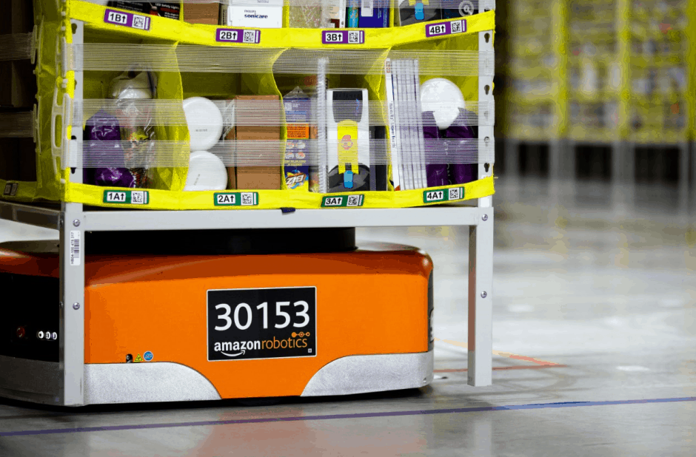
1.1 Amazon’s warehouse model
1. Amazon presently sells millions of products on its website and app. Each of its 149 warehouses ships approximately 10K of products each day.
2. One of the eye-catching innovations in Amazon is their shelf-moving warehouse robots.
3. Amazon offered customers its Prime membership, in which amazon has promised its millions of customers free 2-days shipping on more than 100 million products.
4. Tye Brady, Chief Technologist at Amazon Robotics said , “We want our large objects to be mixed with our small objects to be mixed with our medium objects because it optimises volume.”
A close up of a robotic drive unit. Image: Marty Katz/baltimorephotographer.com

Slide 6
2. Problem Definition
One of the studies on warehouses revealed that 55-60% time of employees who picks the order from warehouse spent travelling.
Traditionally, at an organised warehouse whenever shipment of any product comes, for example whenever a box of 50 soaps comes from supplier, employee at the warehouse searches the shelf for that particular soap.
In our new approach, rather than searching a particular section every time, we remove each individual item and keep it randomly wherever we find vacant space.
Developing an efficient system which will convert this randomness into meaningful time saving and space optimizing decisions is the need of warehouse management.
These warehouses which involve randomness are most effective on B2C businesses rather than B2B businesses, the reason being that customers order a single product, not a whole box of that product.

Slide 7
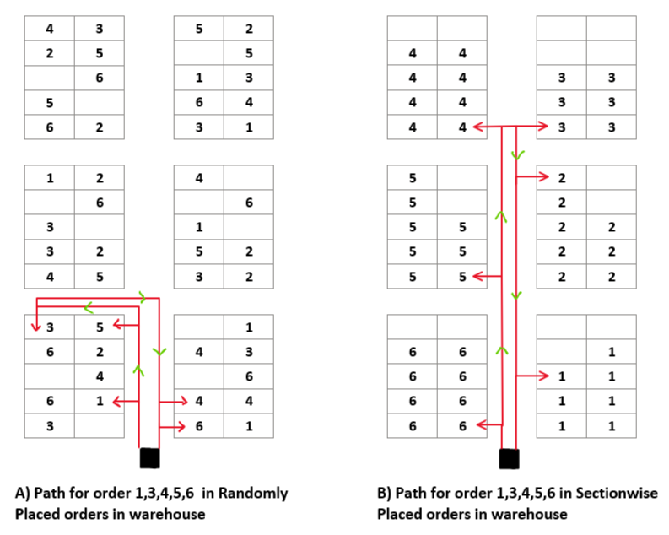
2.1 Why Randomness works?
We found that we can collect most of or all of the order in small subsection of warehouse rather than reaching other end of warehouse for small numbers of products.
When many customers order their set of products that they want we can combine them and derive one path where workers from the warehouse could collect all required items with significantly less amount of time.
Our main task in problem is to get the shortest picking path for given order from customers for given warehouse structure and products locations.

Slide 8
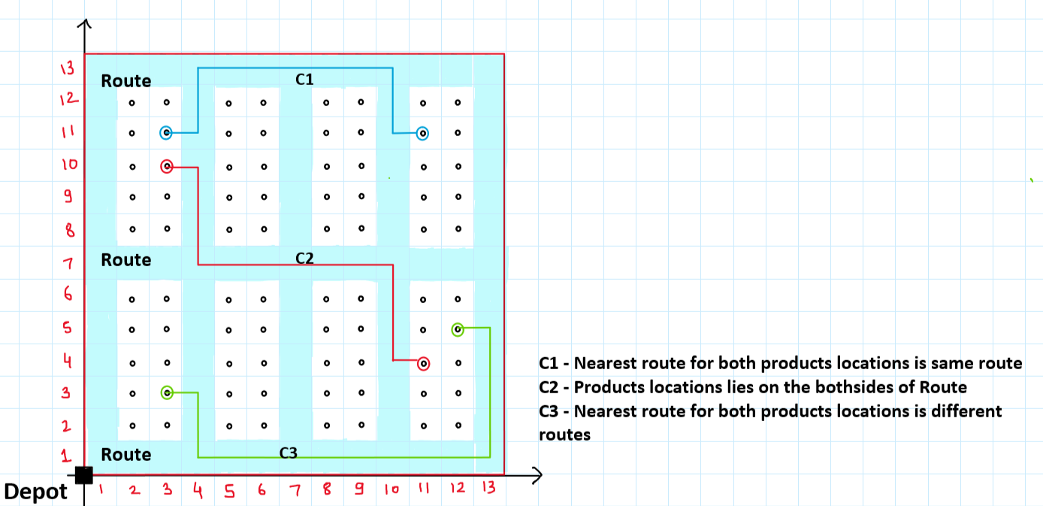
2.2 Defined Warehouse Unit
Repeating Unit of Warehouse structure

Slide 9
2.3 Problem
Problem of finding the optimal path for picking a customer's order resembles the Travelling Salesman Problem (TSP).
TSP, which is a standard problem in combinatorial optimization, is classified as Non-deterministic with polynomial time complexity (NP-hard problem).
Many algorithms such as K-means clustering, Nearest neighbour, 2-opt, Genetic algorithm, Simulated annealing, etc. tried to solve this problem but reached its near optimal solution (approx. 98-99 %).
We will try to solve using one of the above algorithms or a composite version of them.

Slide 10
3. Related Work
3.1 Operations and Operating Expenses in Warehouse [5]
When goods reach the warehouse from the supplier. Receiving goods accounts for almost 10% of warehouse operating expenses.
Inside warehouse goods are then transported to its appropriate location considering its length, width and volume. Placing goods accounts for on an average 15% of warehouse operating cost.
Employees at the warehouse are assigned pick-lists and they start searching, at the end they return to the depot extracting all items from their pick-list. Order picking alone accounts for 50-70% of warehouse operating cost.
55% of the time of picker employees is spent travelling in picker run. Optimizing this time affects operating cost and operating efficiency crucially.

Slide 11
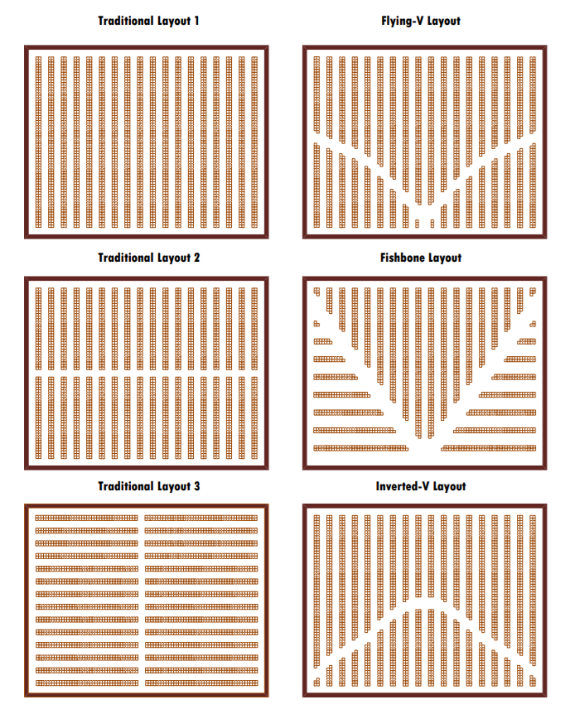
3.2 Warehouse Layouts, Storage strategies and Picking approaches [5]
Layouts -
V-shaped and Fishbone layouts are specially designed to reduce travel distance. They showed 10-20% reduction in travel distances as compared to middle aisle layout.
The Inverted-V layout additionally provides 3% reduction in travel distance.

Slide 12
2) Storage Strategies -
Two major strategies are i) random placement and ii) dedicated placement.
In random storage, incoming goods are placed randomly wherever there is the nearest vacant space.
In dedicated storage strategy Association Rule Mining algorithm is used to utilize space maximally, reason being that it generates inferences about future orders based on historical orders using mining.
Dedicated storage works well where frequency of orders are predictable, but random strategy is preferable when numbers of products are in millions and orders are less predictable.

Slide 13
3) Picking Approaches -
There are 3 main approaches for picking orders
i) Single order picking - pickers are given push-carts and they are assigned items to be collected from single order.
ii) Zonal order picking - Zone picking is a warehouse order selecting method which makes use of zones wherein pickers pick orders inside their own location only.
iii) Batching - Batch picking is when a picker collects a group of orders in one go, at a time.

Slide 14
3.3 Genetic Algorithm for Route Optimization [6]
Genetic algorithm is a heuristic approach for searching inspired by the theory of natural selection given by Charles Darwin.
Genetic algorithm (GA) has its advantage of intelligent searching, where genetic algorithms don’t search for every possible solution (which are in billions and trillion for 20-30 nodes).
we don’t need to define rules for getting a good solution as defining any mathematical expression of this knowledge is impossible due to the complexity of the system.
In GA, the problem is encoded as sequence of products (need to be picked) by the same analogy of sequence of genes in chromosomes of biological organisms.
intelligent search is implemented using 3 operators - Selection, Crossover, Mutation

Slide 15
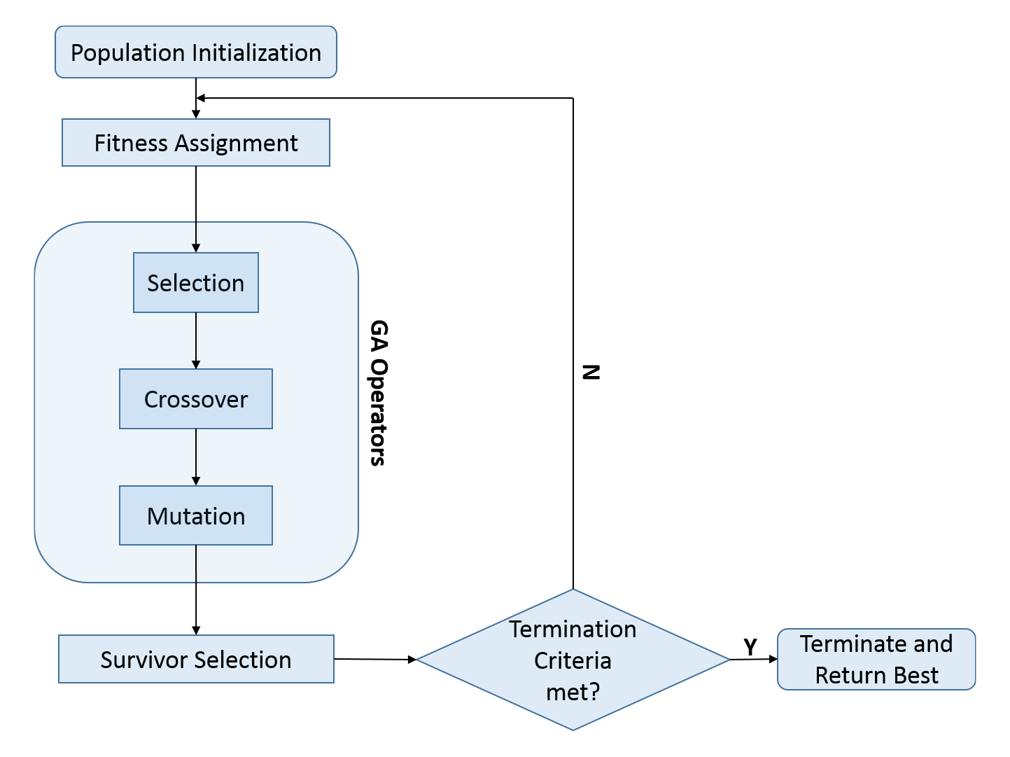
Flowchart for Genetic Algorithm

Slide 16
4. Methodology
Naive approach for finding such a solution is trying out every possible route out there and then choose the one with minimum distance.
Problem is solvable within a certain time limit(say 5-30 sec) through naive approach when size of order is <15 as after 15 possible routes surpasses quadrillion combinations (10^15).
There are several heuristic algorithms to solve such as 2-opt, Genetic Algorithm, Nearest Neighbour, Simulated Annealing, Christofides Algorithm, etc. We choose a 2-opt algorithm to get a solution for our problem.
Nodes (# Orders to optimize) | Combinations to analyse
5 | 120
7 | 5040
10 | 3.62 Million
15 | 1.307 Trillion
20 | 2.43 Quintillion

Slide 17
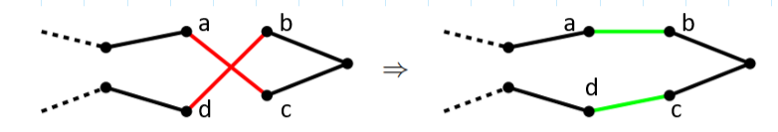
4.1 2-opt Algorithm
In the 2-opt algorithm as the name suggests, we opt 2 edges for alternative 2 edges to make the overall route shorter than previous.
Consider crossing edges in a route, ac and bd. We want to alter this part to be like ab, cd. The edges between b and c, we want the crossing part to change from acbd to abcd.
we pick the appropriate ’b’ and ’c’ and swap them and we should flip their orders to make the new 2-opt tour valid.

Slide 18
4.1.1 Pseudo Code for 2-opt Algorithm
Evaluate the Distance matrix
Define tour T randomly or output of Nearest Neighbour Algo.
for i=1:n-2,
for j=i+2:n,
Evaluate d1 = Sum of length of 2 edges
Evaluate d2 = Sum of length of 2 edges when targets swapped
If d1 > d2
Swap indices of targets in previous tour T
else
end
end
end

Slide 19
4.2 Software Flow
Feed Distance matrix to 2-opts Algorithm
Get Map of products locations and vacant places
7
2
Code for placing products randomly in Warehouse
3
8
1
6
Get nearly optimized route for picking Orders list
List of all Products we want to keep in Warehouse
4
Get Distance Matrix
Orders list of products to be picked from Warehouse
Code for distance of each product from its remainings
5

Slide 20
5. Result and Discussion
Input -
Your Order List is: ['product_1 ', 'product_5 ', 'product_15', 'product_25', 'product_35', 'product_45', 'product_55', 'product_65', 'product_75', 'product_85', 'product_30', 'product_41', 'product_59', 'product_69', 'product_25']
Orders Available in Warehouse: ['product_1 ', 'product_5 ', 'product_15', 'product_25', 'product_35', 'product_45', 'product_55', 'product_65', 'product_30', 'product_41', 'product_59', 'product_69', 'product_25']
Orders Not Available in Warehouse: ['product_75', 'product_85']
Output -
2-optimal distance for given order in Organized warehouse is 140.0 units
2-optimal route is
['product_1 ', 'product_25', 'product_25', 'product_15', 'product_5 ', 'product_30', 'product_41', 'product_45', 'product_35', 'product_59', 'product_55', 'product_69', 'product_65']
2-optimal distance for given order in Random placement warehouse is 93.0 units
2-optimal route is
['product_1 ', 'product_30', 'product_15', 'product_65', 'product_69', 'product_5 ', 'product_45', 'product_41', 'product_59', 'product_25', 'product_25', 'product_55', 'product_35']

Slide 21
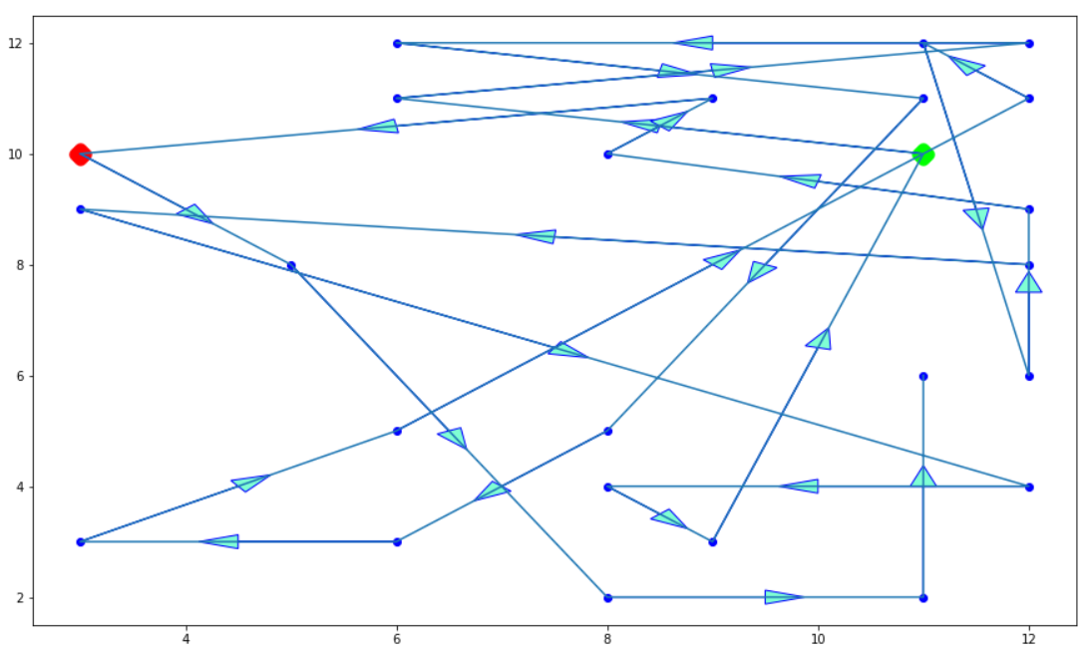
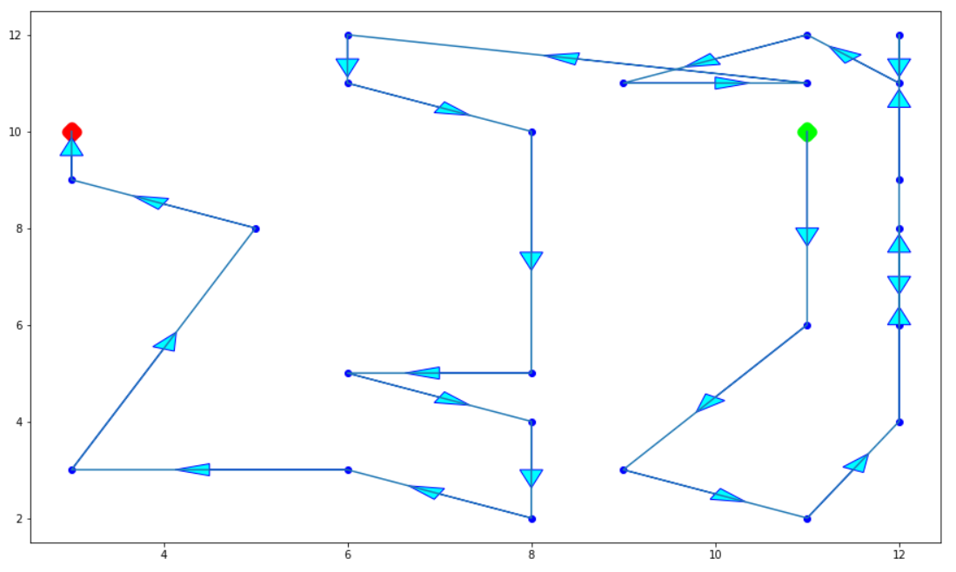
Initial route before optimization
Route after optimization using 2-opt algorithm

Slide 22
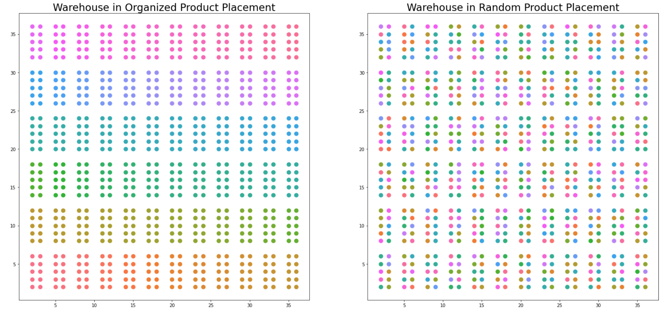
Warehouses before we pick our first order

Slide 23
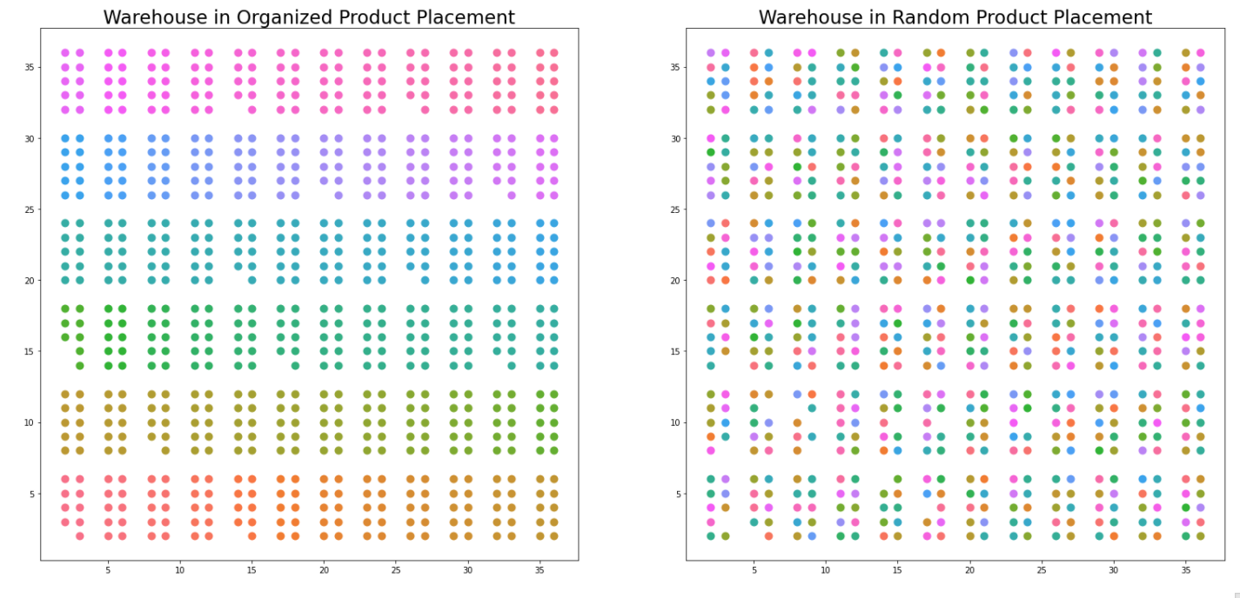
Warehouses after we pick our first order
All of our orders we can collect in small subsection of warehouse.

Slide 24
Discussion
We found that we can collect most of or all of the order in small subsection of warehouse as a result we get distance of 93 units (≈35% less) in randomly placed products and 140 units in organized products.
We have seen from the above example that a 2-opt algorithm solves a given problem in a near optimal way which can be used practically and makes very little difference as compared to optimal solution.
2-opt algorithm given solution accuracy in the range of 95 - 99.9% of optimal solution. Main problem with the 2-opt algorithm is that, It sometimes gets stuck in local minimum rather than moving toward global minimum distance.
Surprisingly it is majorly dependent on the initial point of trip we are choosing. This problem is solved using a number of different initial points and choosing the best of them.
We can use similar approach in Vehicle routing problem for delivery of products to customers.

Slide 25
6. Futurework
The above implementation of the 2-opt algorithm is a simple implementation of 2-opt . Instead, we can use the composite structure of the algorithm using the output of Nearest Neighbor as input to the 2-opt algorithm. Similarly output of 2-opt as input to Genetic Algorithm. In this way we can increase accuracy as compared to only using a 2-opt algorithm.
We can involve Robots for picking and carrying orders using artificial intelligence. We can automate the process of scanning product’s location using technologies like Barcode Tagging on each warehouse location. We can use historic orders to optimize processes further such as frequently ordered items or items that are ordered together.
To improve the algorithm further we can divide warehouses in small subsections and keep a group of items which are ordered together by analysing consumer buying behaviour.

Slide 26
7. References
Project Link -
https://colab.research.google.com/drive/1WkvFVoCr7zLkUE8yrdMGY3rFDUl8Vsbk?usp=sharing
https://www.theengineer.co.uk/inside-amazons-technology-test-bed/ [1]
https://www.diva-portal.org/smash/get/diva2:1413926/FULLTEXT01.pdf [2]
https://essay.utwente.nl/72060/1/Slootbeek_MA_EEMCS.pdf [3]
https://www.skuvault.com/blog/amazon-order-management-process/ [4]
https://www.researchgate.net/publication/260742754_An_Overview_of_Warehouse_Optimization [5]
Applied Sciences | Free Full-Text | Optimization of Warehouse Operations with Genetic Algorithms | HTML [6]

Slide 27
Thank You

